Slide 1
Meeting Week 15
Parameter recovery
  The system matches the model exactly
    Only difference the parameters of the model are detuned with + / - 10%
Experiment
  Trajectories without multisine
    Are able to recover the parameters
  Current problem:
    Adding multisines on top of the current trajectories

Slide 2
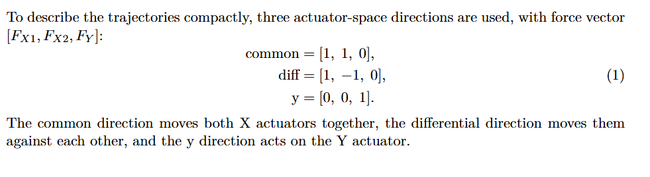
Trajectories
The different modes concept is taken from Garciá

Slide 3
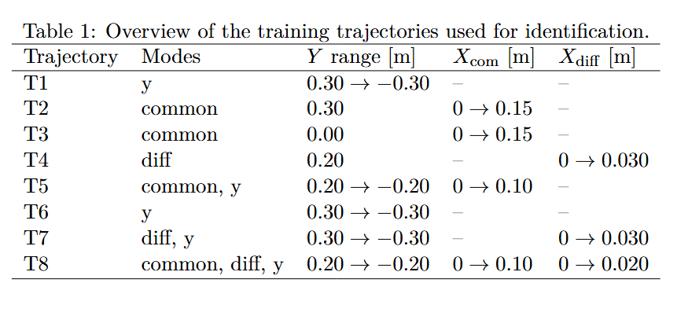
Trajectories
Note: T8, X moves in the same direction, but also creates an offset

Slide 4
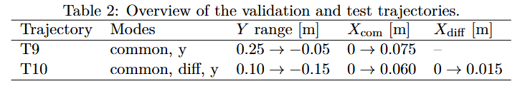
Trajectories

Slide 5
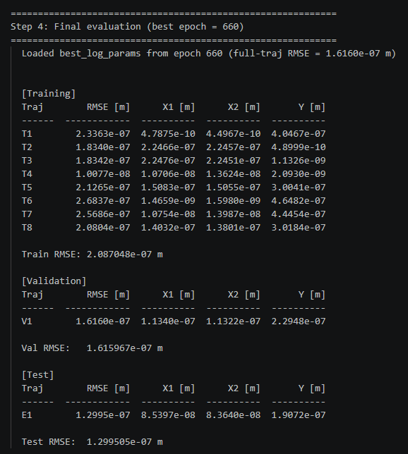
Trajectory – parameter recovery
Out of 1500 epochs, best validation RMSE for epoch 660

Slide 6
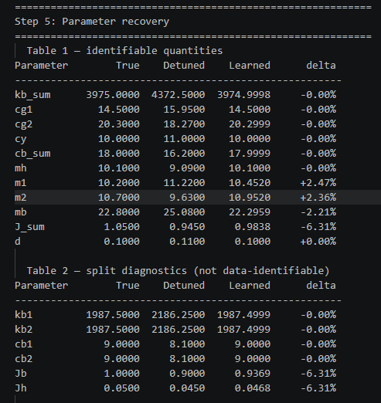
Trajectory – parameter recovery
Mainly J_sum
m1, m2 and mb

Slide 7
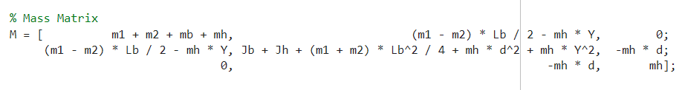

Trajectory – parameter recovery
m1+m2, and mh are not independently isolated in the mass matrix
J_sum is likely under-recovered because the theta inertia is not excited strongly enough.

Slide 8
Multisine force injection
We use force injection because the added excitation appears directly in the recorded total plant input u_total, which is the input used for open-loop force-to-position identification.
  Closed-loop
  The model uses u_total and position output (q1)
  u_total = u_feedback + f_inj

Slide 9
Diagnostics for multisine
Needs to answer the following:
If I inject force after the controller
    which injected-force frequencies survive the closed-loop feedback
    which surviving frequencies produce measurable plant motion

Slide 10
Diagnostics for multisine
Diagnostic Probe
A broadband periodic Schroeder multisine is injected as an additive force after the controller in the Simulink model. (odd frequencies from 1 Hz up to just below Nyquist)
The multisine repeats every 1 s, so it excites frequencies that fit exactly in that time window, such as 1, 3, 5, ... Hz. These frequencies align with the FFT grid, which allows clean frequency-response estimates.
The same 1 s multisine is repeated twice. The first repetition is not used for the estimate, because the system may still be reacting to the sudden start of the excitation. The second repetition is used for the FFT, because the response is closer to the steady response to the repeated multisine.

Slide 11
Diagnostics for multisine
Diagnostic Probe
For each force direction m, the MIMO signals are projected onto that same direction:
F_m,inj(f) = injected force in direction m
U_m,total(f) = total plant input force in direction m
Q_m(f) = measured q1 motion in direction m
This gives a directional SISO-like experiment for each mode: common, diff, and y.

Slide 12
Diagnostics for multisine
Estimated Quantities
S_in,m(f) = U_m,total(f) / F_m,inj(f)
S_in,m is a directional closed-loop input-sensitivity estimate. It shows how much of the injected post-controller force remains in the total plant input after feedback action. It is not the full MIMO sensitivity matrix.
G_m(f) = Q_m(f) / U_m,total(f)
G_m is a directional plant FRF estimate. It shows how much measured q1 motion is produced per actual total actuator force.
Their product gives the effective injected-force-to-motion frequency response:
G_m(f) S_in,m(f) = Q_m(f) / F_m,inj(f)
This response is used to select the useful multisine frequency band.
The diagnostic is repeated for several frozen Y operating points, and the final frequency bounds are chosen conservatively as the worst case across directions and operating points.

Slide 13
Diagnostics for multisine
Frequency Band Selection
The lower bound f_low is chosen from the directional input-sensitivity estimate:
S_in,m(f) = U_m,total(f) / F_m,inj(f)
It marks the first frequency where the injected force is no longer strongly rejected by the feedback loop.
Criterion:
|S_in,m(f)|² > 0.1 (at least 10% of the injected force power remains in the total plant input)
The final f_low is selected conservatively as the worst case across all force directions and Y operating points.

Slide 14
Diagnostics for multisine
Frequency Band Selection
The upper bound f_high is chosen from the effective injected-force-to-motion response:
G_m(f) S_in,m(f) = Q_m(f) / F_m,inj(f)
This quantity tells how much measured q1 motion is produced by the injected force.
The script applies a tail-energy rule to:
|G_m(f) S_in,m(f)|²
Starting from high frequencies, it computes how much response energy remains above each candidate frequency. f_high is chosen as the highest frequency for which the remaining tail energy is still at least 5% of the total response energy in the usable band.
Above f_high, the injected force is assumed to add little useful motion response for identification.

Slide 15
Multisine design
Purpose:
Add a designed force multisine on top of the nominal motion trajectories.
Inputs from diagnostics
f_low = lowest useful injected-force frequency
f_high = highest useful injected-force frequency
A_max = RMS force budget per mode (we take 40% of the max from the hardware limits)
Design choice:
Final multisine only excites frequencies inside [f_low, f_high].

Slide 16
Multisine design
Each experiment first defines a reference motion:
r(t) = [X1_ref(t), X2_ref(t), Y_ref(t)]
A feedback controller tracks this reference:
u_q1(t) = Cfb (r(t) - q1(t))
The multisine is injected after the controller:
u_total(t) = u_q1(t) + f_sim(t)
The controller is designed per trajectory at:
Y_op = Y_initial
and then kept fixed during the trajectory.

Slide 17
Multisine design
Mode-Based Excitation
The force multisine is applied in physical force directions:
common = [1, 1, 0] symmetric X force
diff = [1, -1, 0] differential / yaw force
y = [0, 0, 1] Y force
For multi-mode trajectories:
all active modes are injected simultaneously

Slide 18
Multisine design
Schroeder Multisine Construction
For each active mode, a periodic odd-harmonic Schroeder multisine is generated: f_low <= f_k <= f_high
Only odd harmonic lines are used
  ..., f0, 3f0, 5f0, ...
  f0 = 1 Hz
Schroeder phases are used to reduce crest factor
Each trajectory is padded to an integer number of 1 s periods:
  N is a multiple of N_period
  This keeps the multisine periodic and leakage-free.

Slide 19
Multisine design
Each active mode receives a different phase seed:
Purpose:
  reduce correlation between simultaneously injected modes
Train validation and test phase also differs (frequency stays the same)
Note:
  Different seeds are a decorrelation heuristic.
  They do not make the modes strictly orthogonal.
Notes:
The base Schroeder phase is:
phi = -pi * idx .* (idx-1) / F;
Then the script adds a seed-dependent phase shift:
phi = phi + 2*pi*(k*f0)*(seed-1)/(7*f_high);
So the frequencies stay the same, but the phases change.

Slide 20
Multisine design
Enforce Hardware limits
position and velocity limits on q1
acceleration limits on reference r
peak force limits on u_total
RMS force limits on u_total

Slide 21
Multisine output
Identical trajectories as without multisine. Cannot recover parameters with:
  Segment length 650
  Segment length 4000
Notes:
Currently not using a proper method to find best segment length
Step response hard time because…
FFT not used currently
Planning on using FRFs instead..

Slide 22
Question
Multisine is only causing issues. Need to design around slowest dynamics, what is the best approach for this?
  Step response how to do for closed-loop, mimo, LPV?

Slide 23
New joint meeting

Slide 24
To do
Fix experiment design for multisine
Afterwards can move on to augmenting the system

